Slide 1
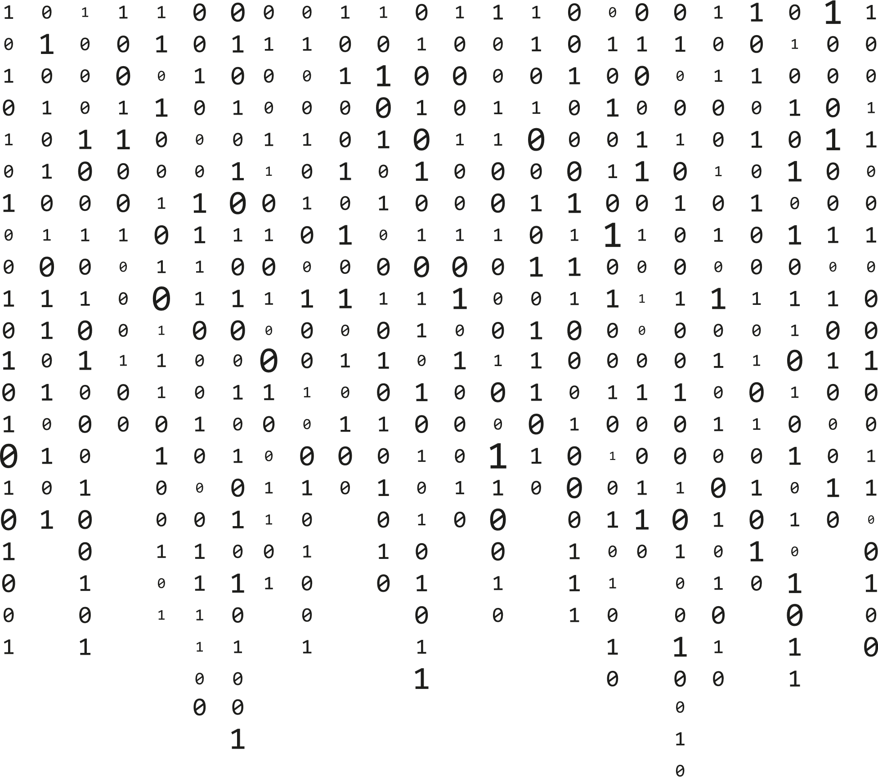

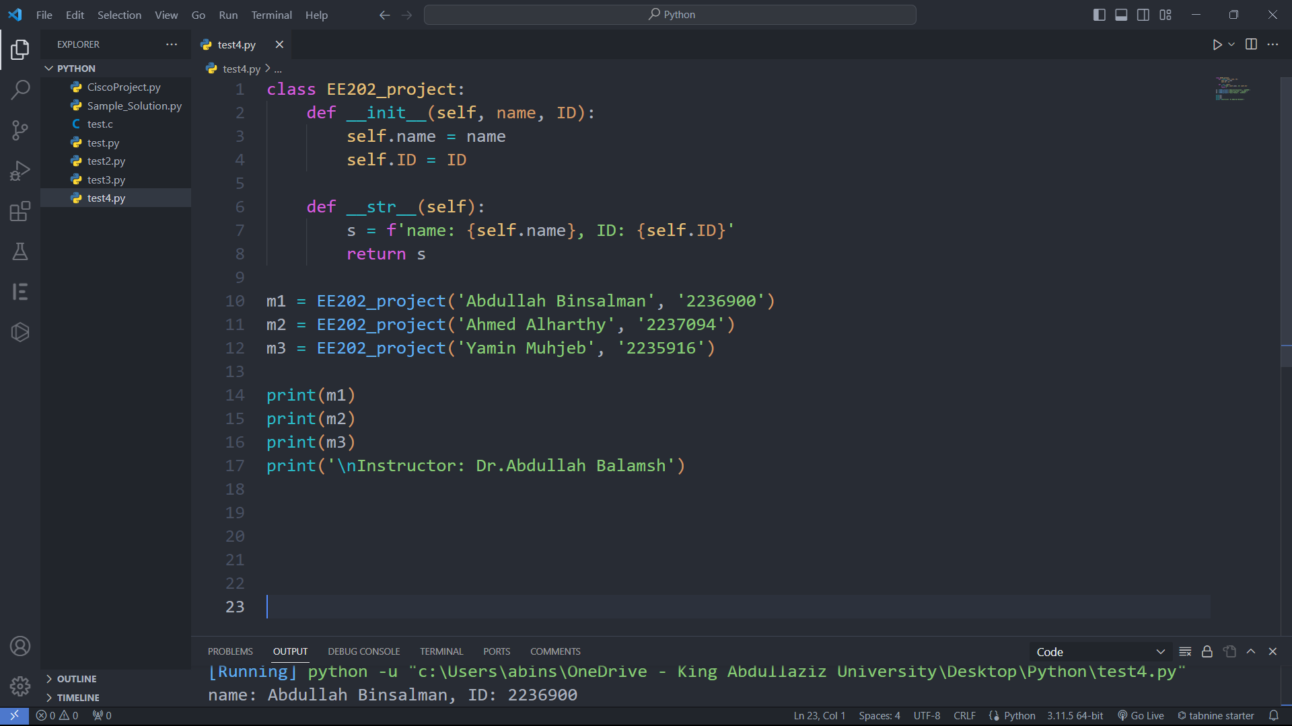

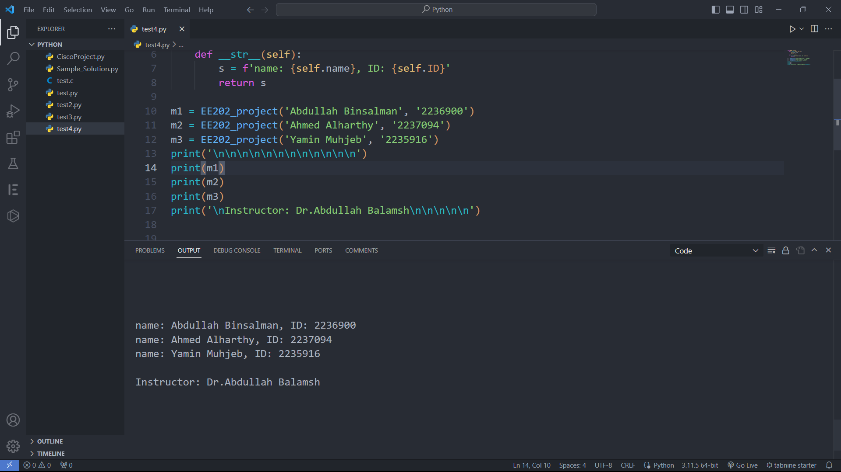

EE-202 Project
Student Registration System.py

Slide 2


Agenda
01
02
03
Introduction and Project Overview
Technical Implementation
Application preview

Slide 3
INTRODUCTION
Project Overview
Classes Structure
User Interface Pages
Course Class
Semester Class
Student Class
Starting Page
List of Students
Add Students
Add Semester
Add Course
Students Details

Slide 4
Classes Structure
Course
name: str title: str subjectNumber: str hours: int section: str mark: int
setTitle(newTitle): setName(newName): setSubjectNumber(newSubjectNumber): setHours(newHours): setSection(newSection): setMark(newMark): setGrade(newgrade): getName(): getTitle(): getSubjectnumber(): getHours(): getSection(): getMark(): getGrade(): getPoints(): getCourse(): __str__():
Semester
Semester_name: str Courses: list
edit_semester_name(Semester_name) add_course(newCourses): get_courses(): del_course(REcourse): GetSemName(): getPoints(): getHours(): getGPA(): __str__():
Student
name: str ID: str semesters: list
setName(name): setID(ID): addSemester(semester): getName(): getID(): getSemesters(): getHours(): getPoints(): getGPA(): __str__():

Slide 5
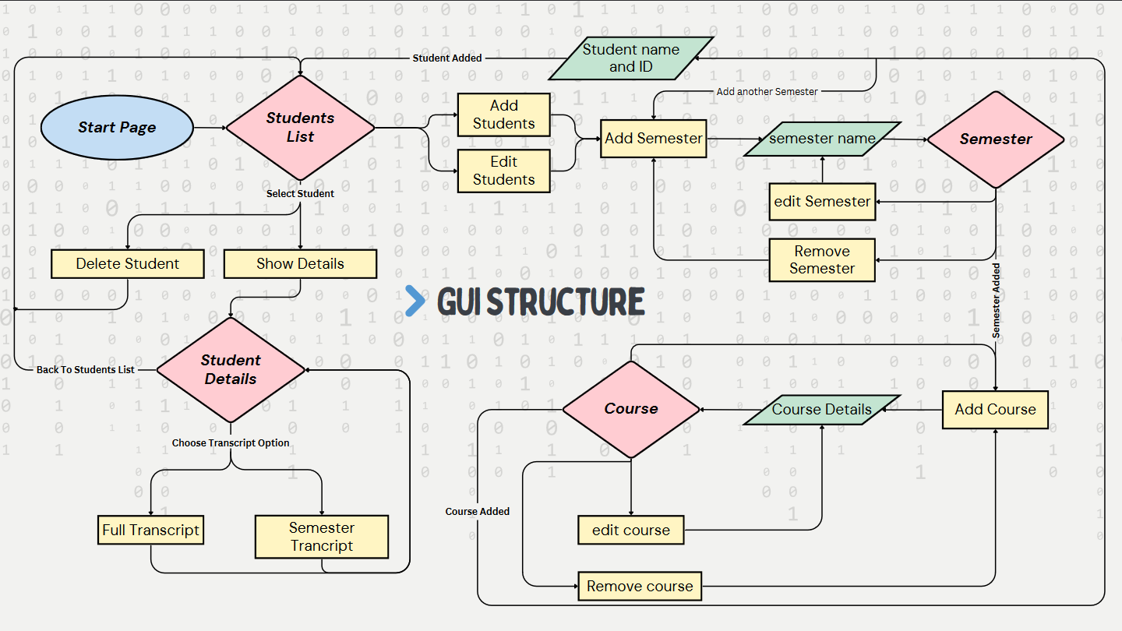

Slide 6
Python & UI Files
CODE DETAILS
GUI Design
Main File
Functions
List of students
printing transcript
Technical Implementation

Slide 7
GUI Design
WIDGETS USED IN QT DESIGNER:
QPushButton
QLineEdit
QComboBox
Qlabel
QTableWidget
QPlainTextEdit

Slide 8
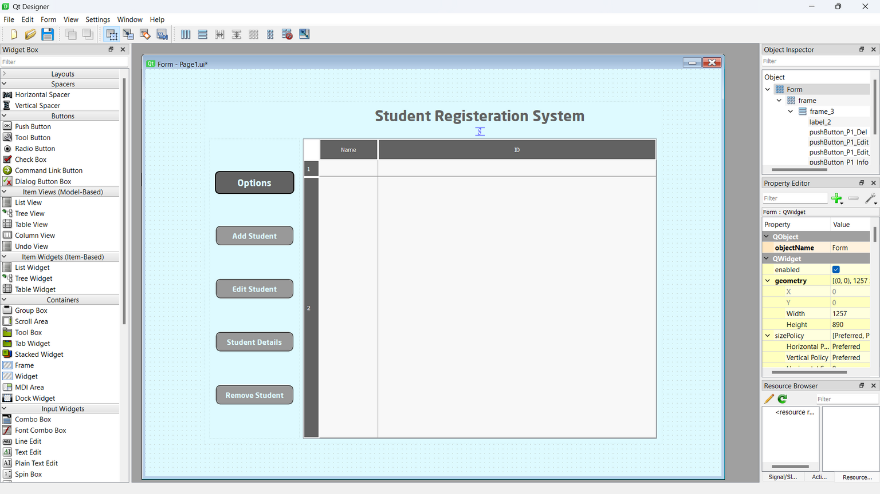
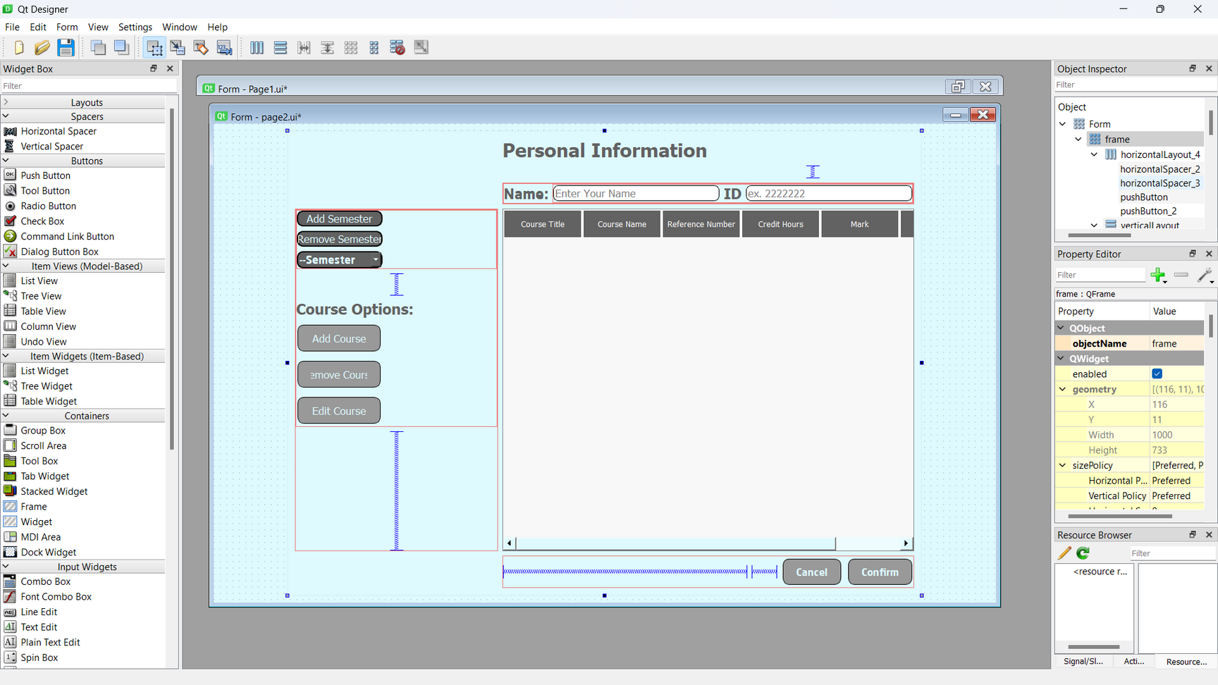
GUI Design
Pages Designed By QT Designer

Slide 9
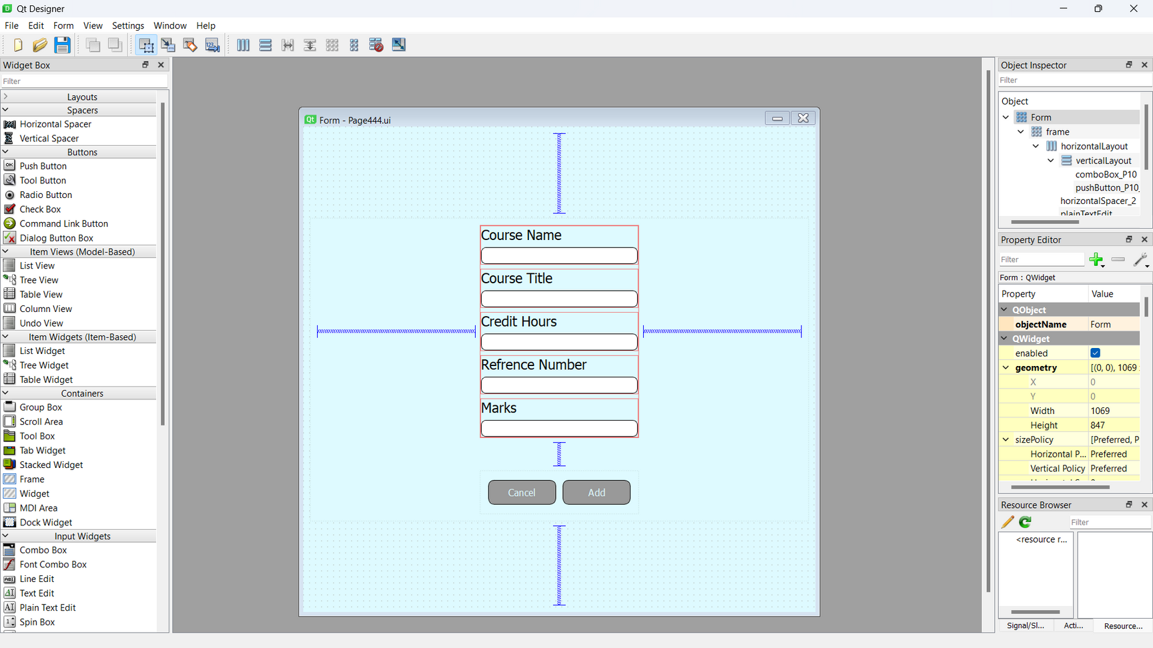
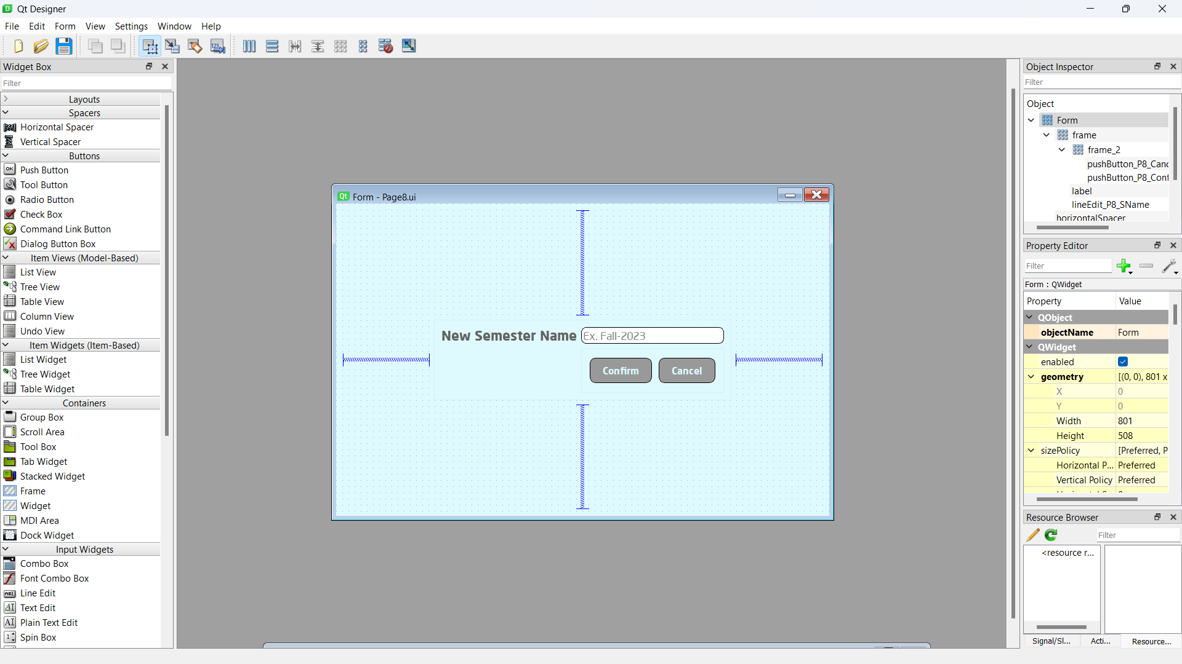
GUI Design

Slide 10
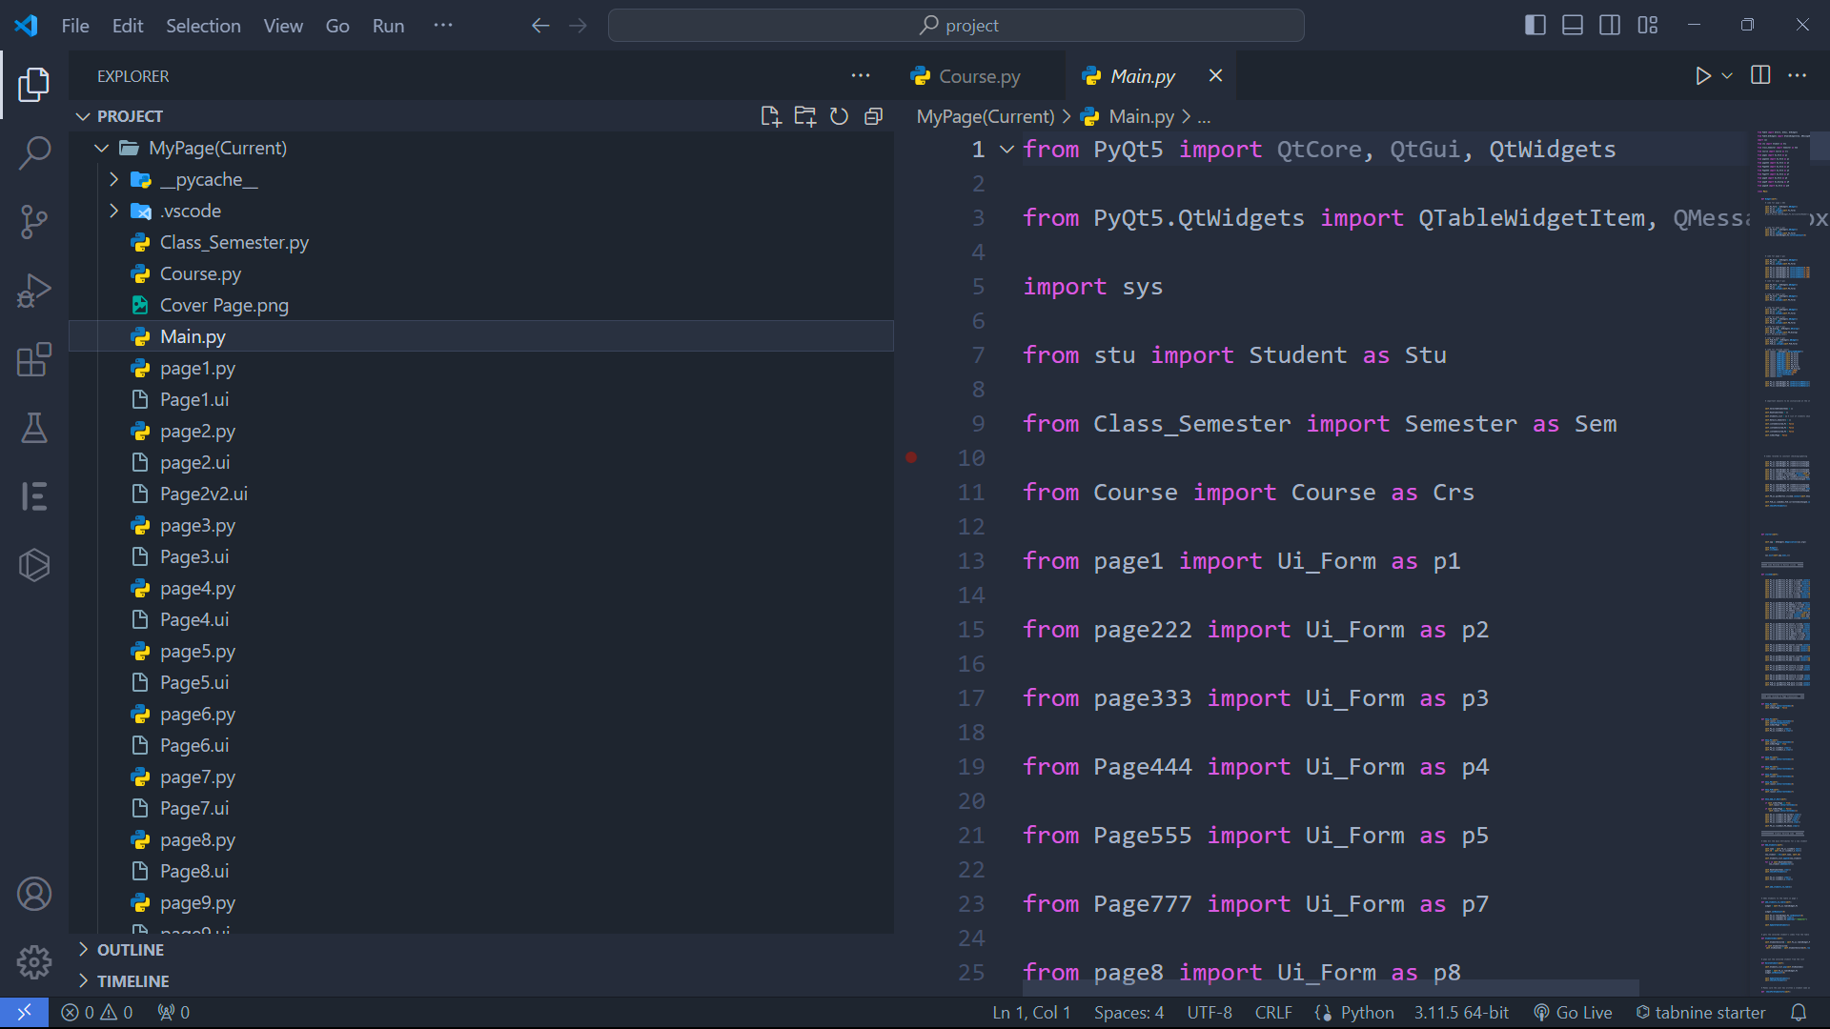
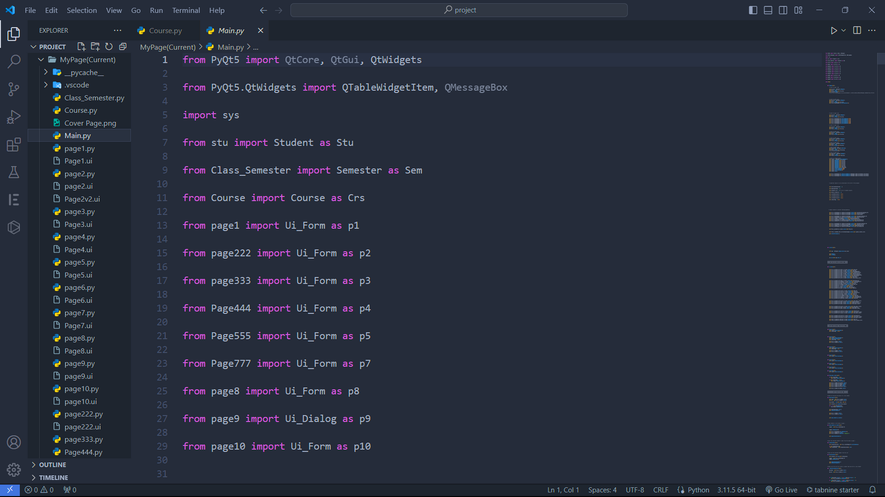
Main File
All files imported to the Main.py file

Slide 11
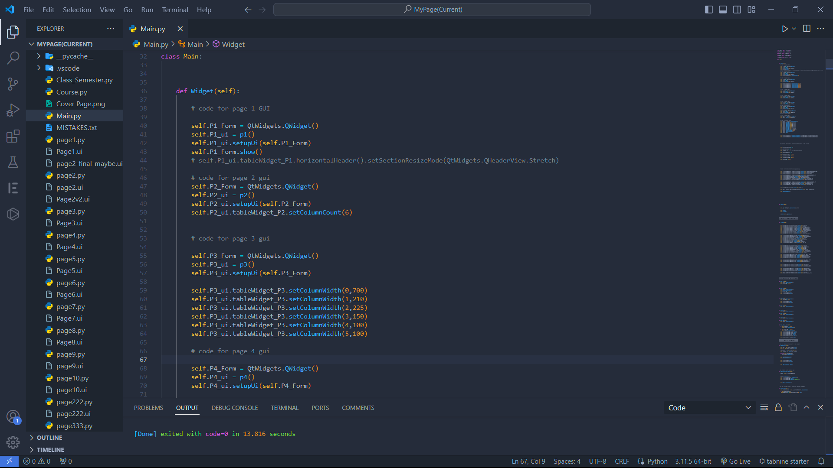
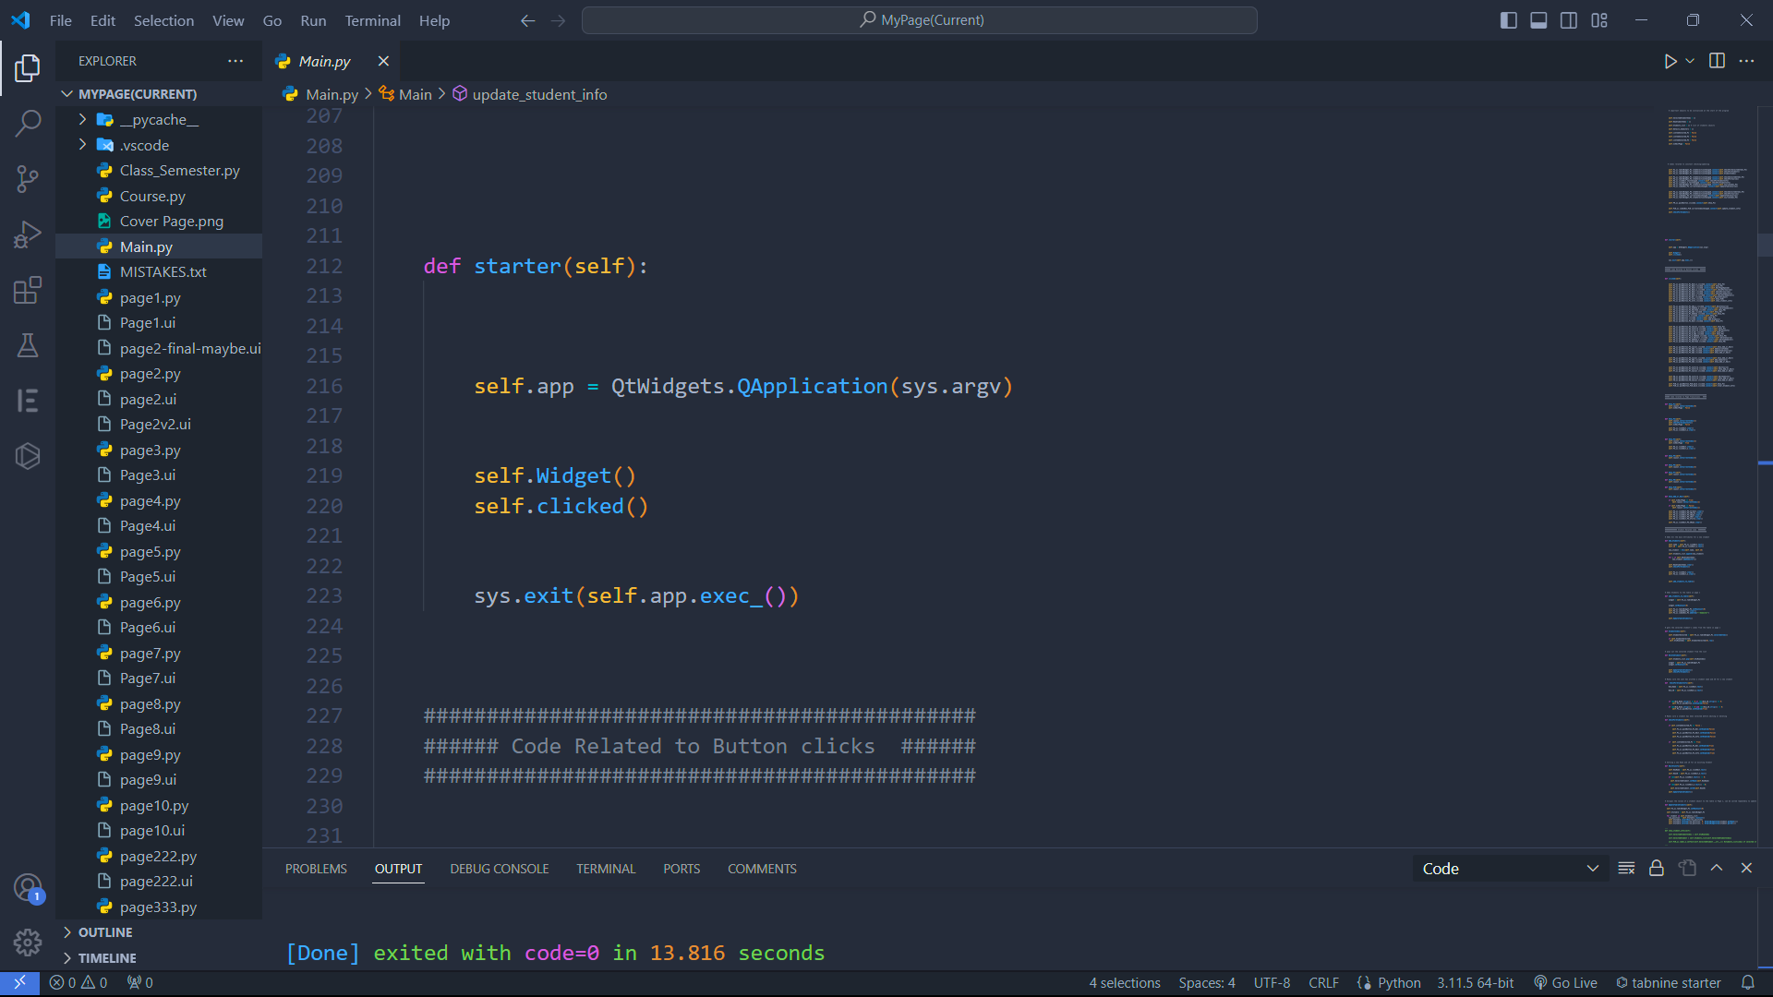
Main Functions

Slide 12
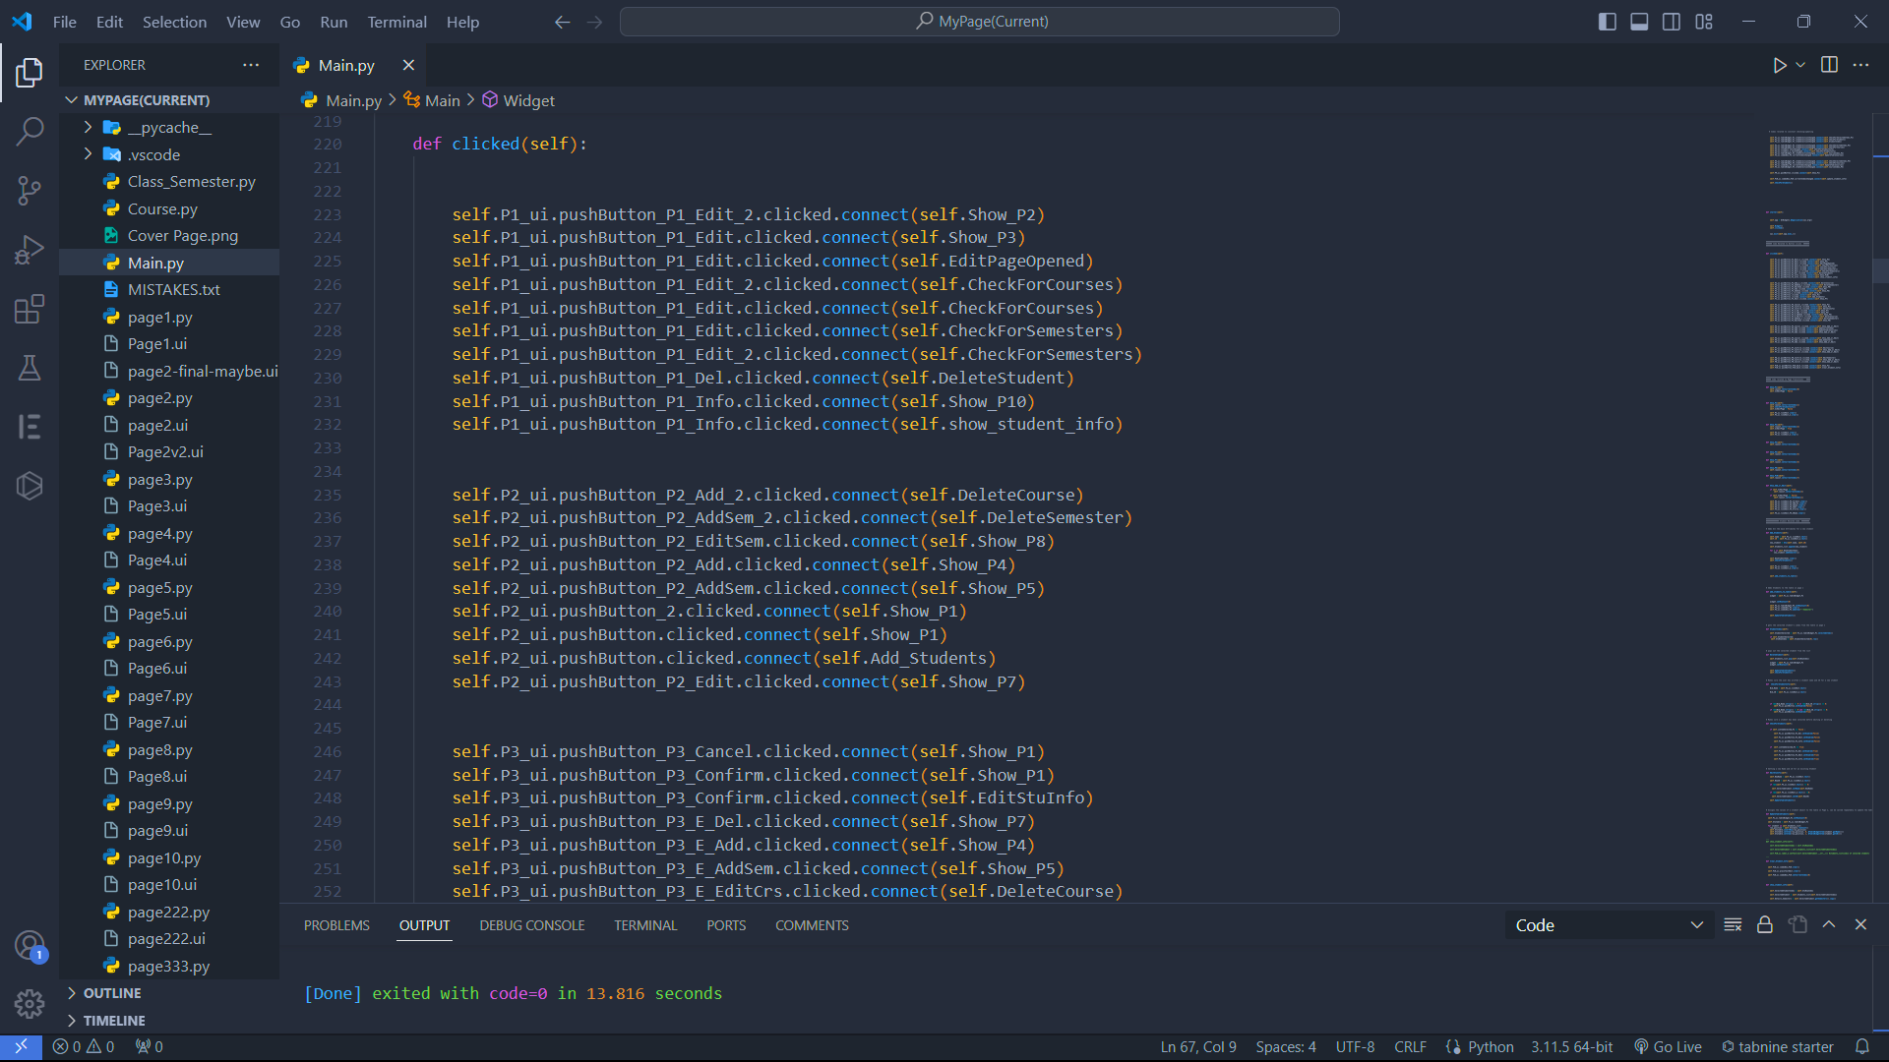
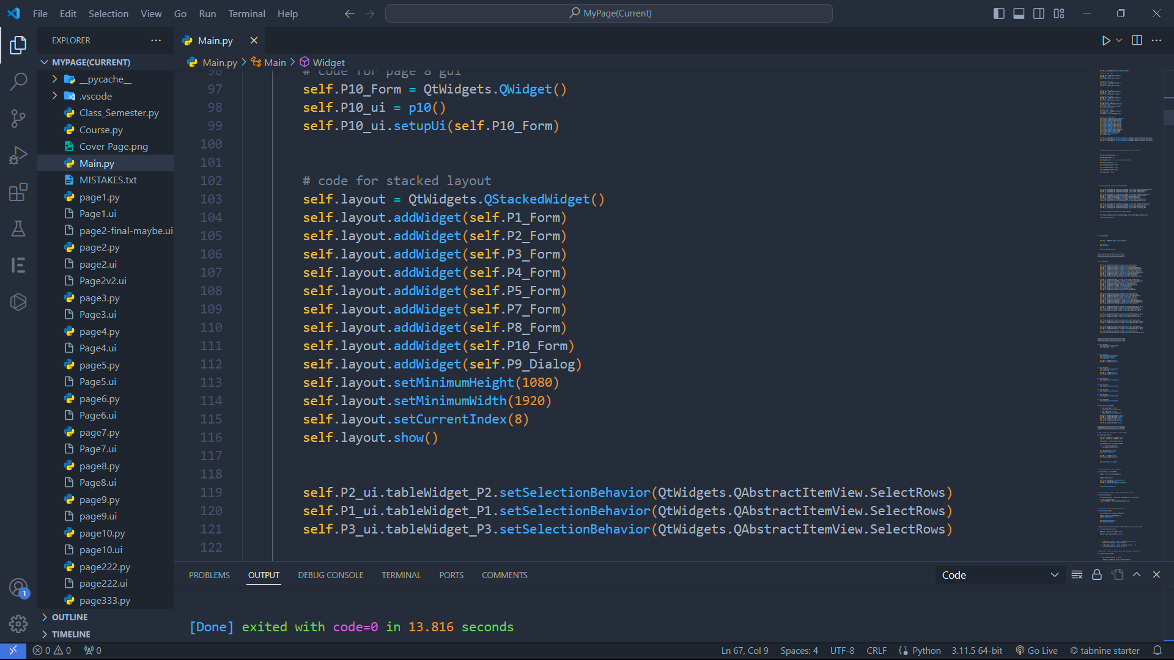
Main Functions

Slide 13



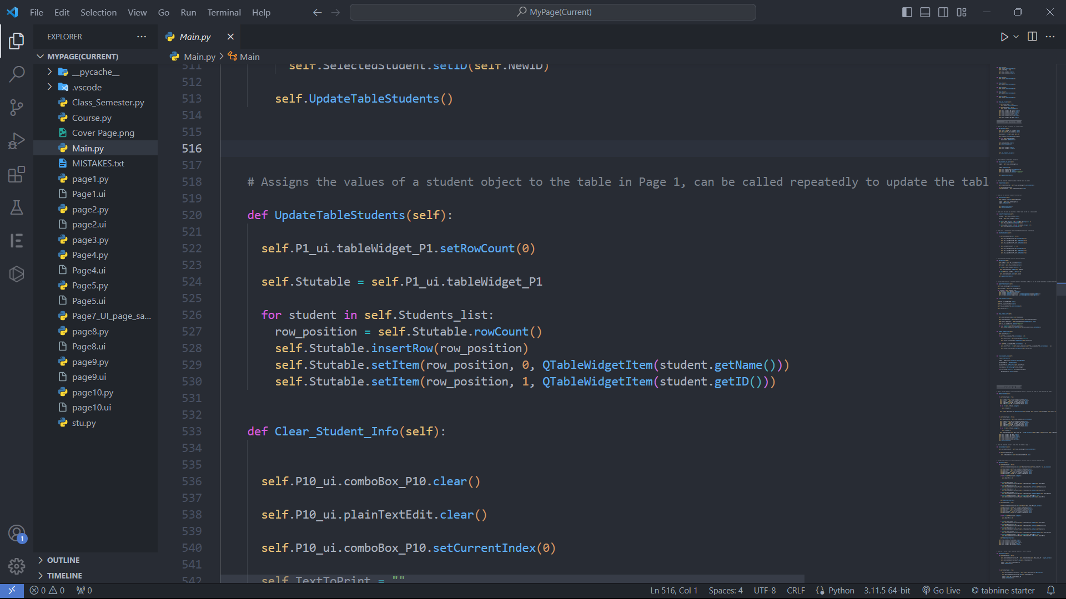
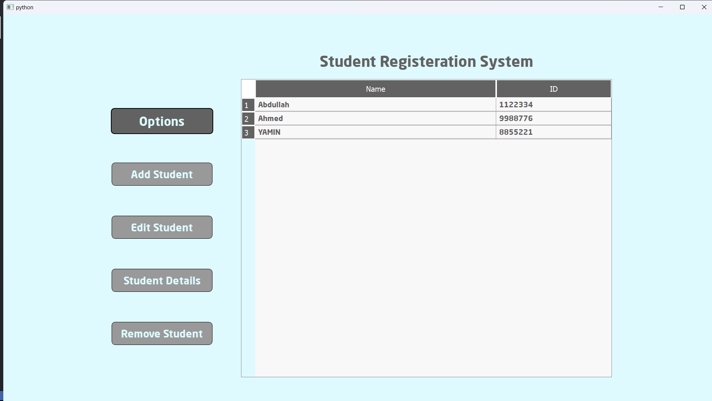
List of students
Student_ 1
Student_ 2
Student_ 3
object of class “student”

Slide 14
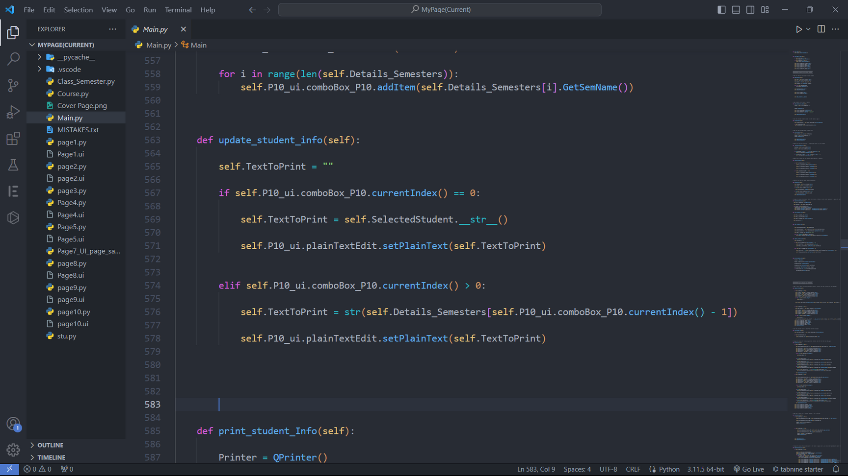
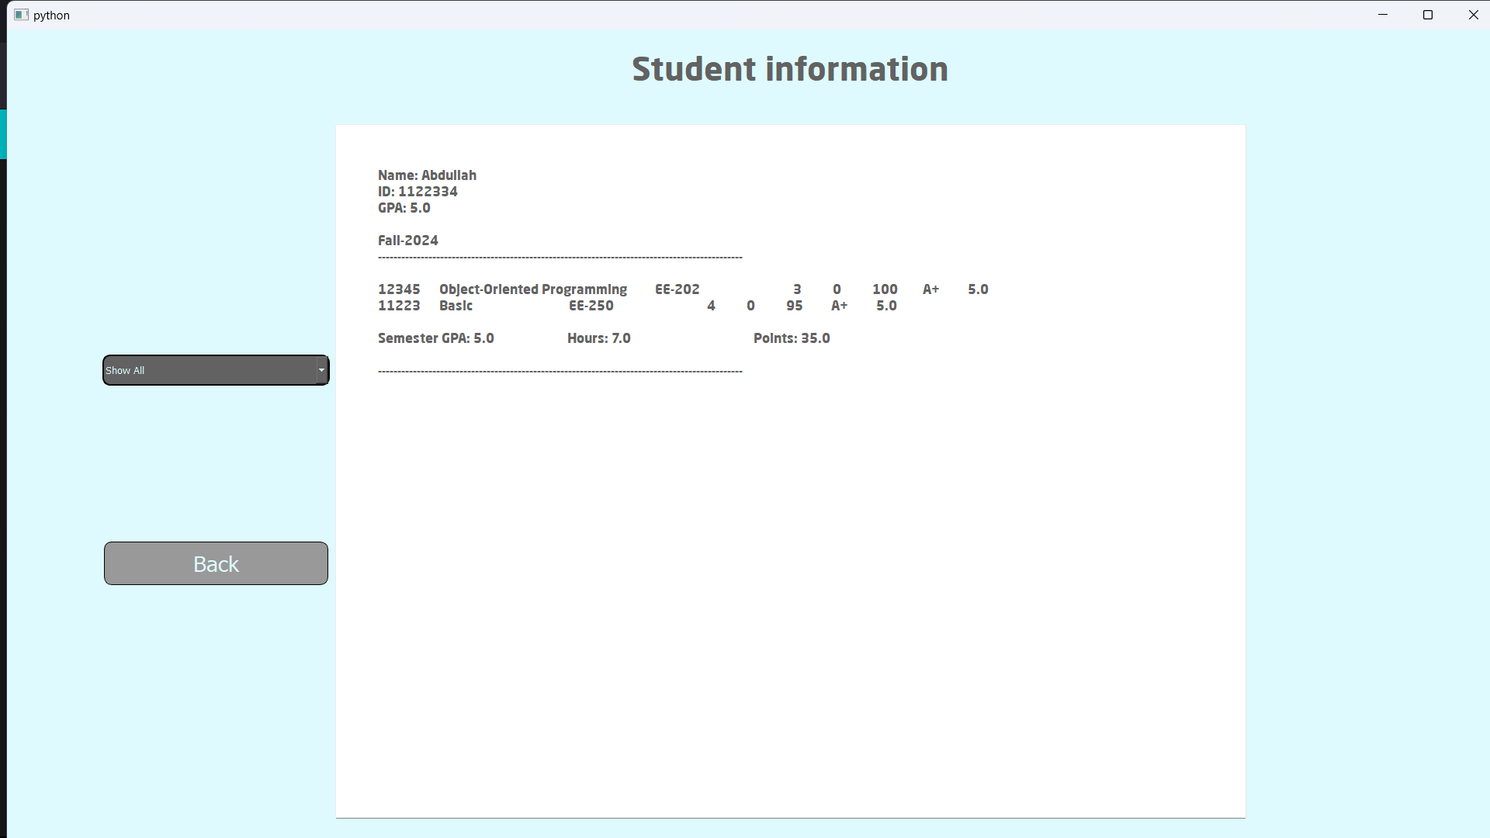
printing transcript
using __str__ method

Slide 15
Walkthrough
Project
Preview
Main Pages
Feature Highlights

Slide 16
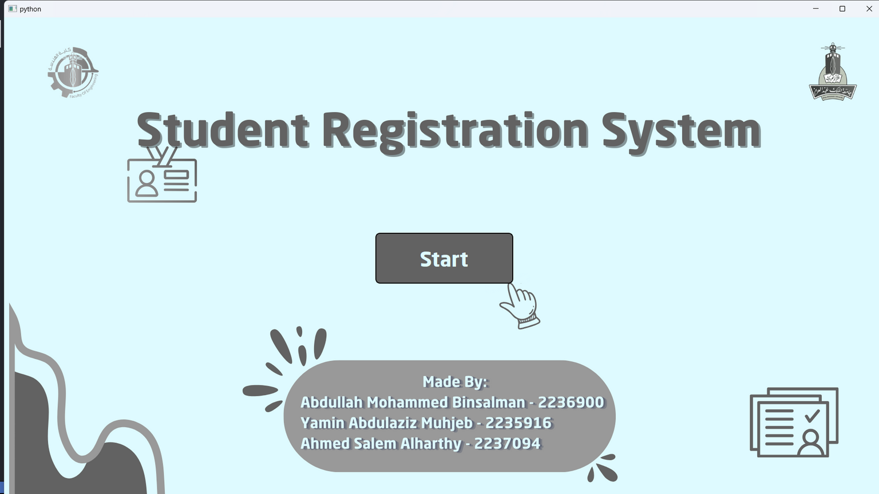

Slide 18
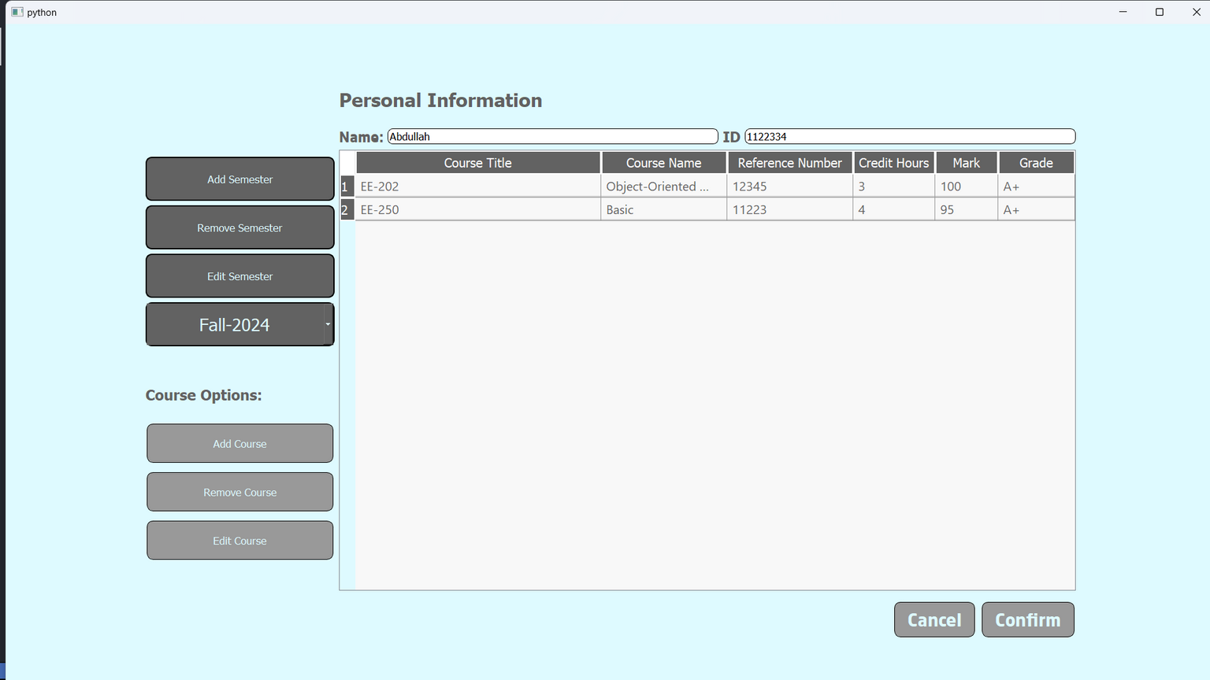

Slide 19
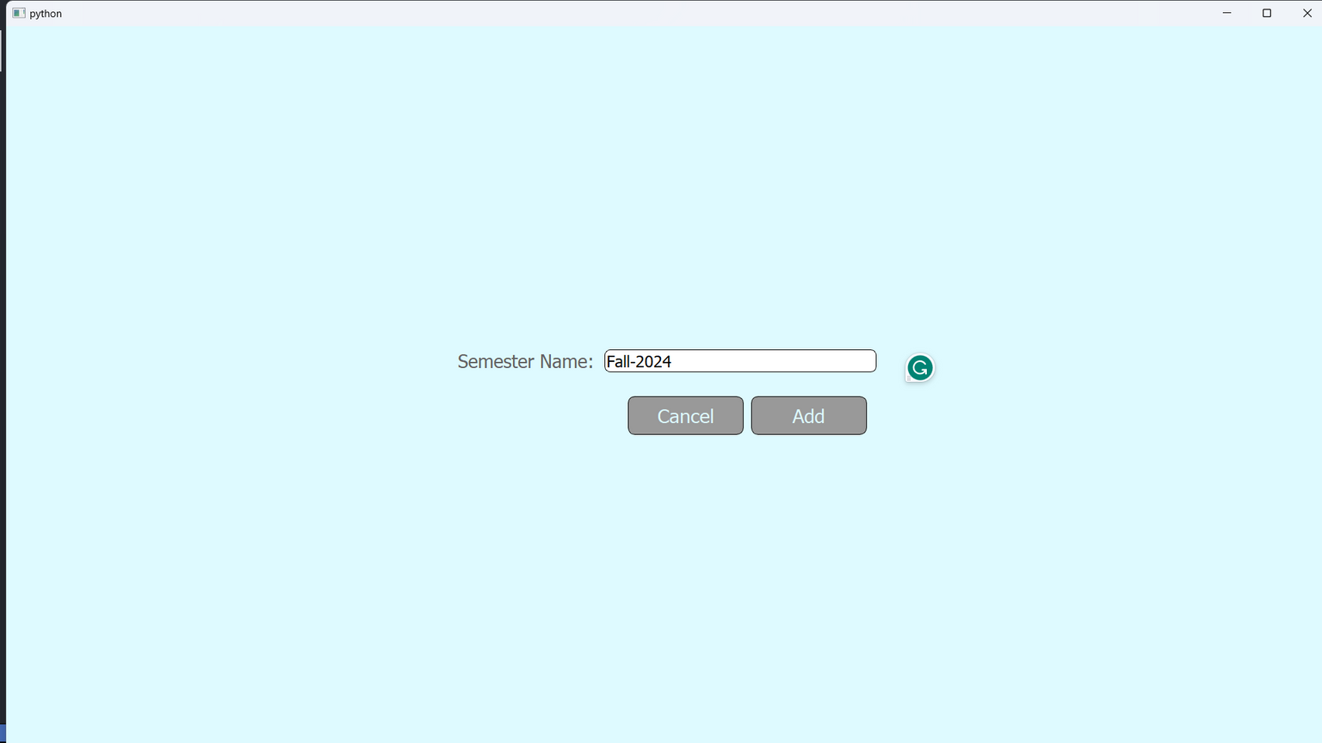

Slide 20
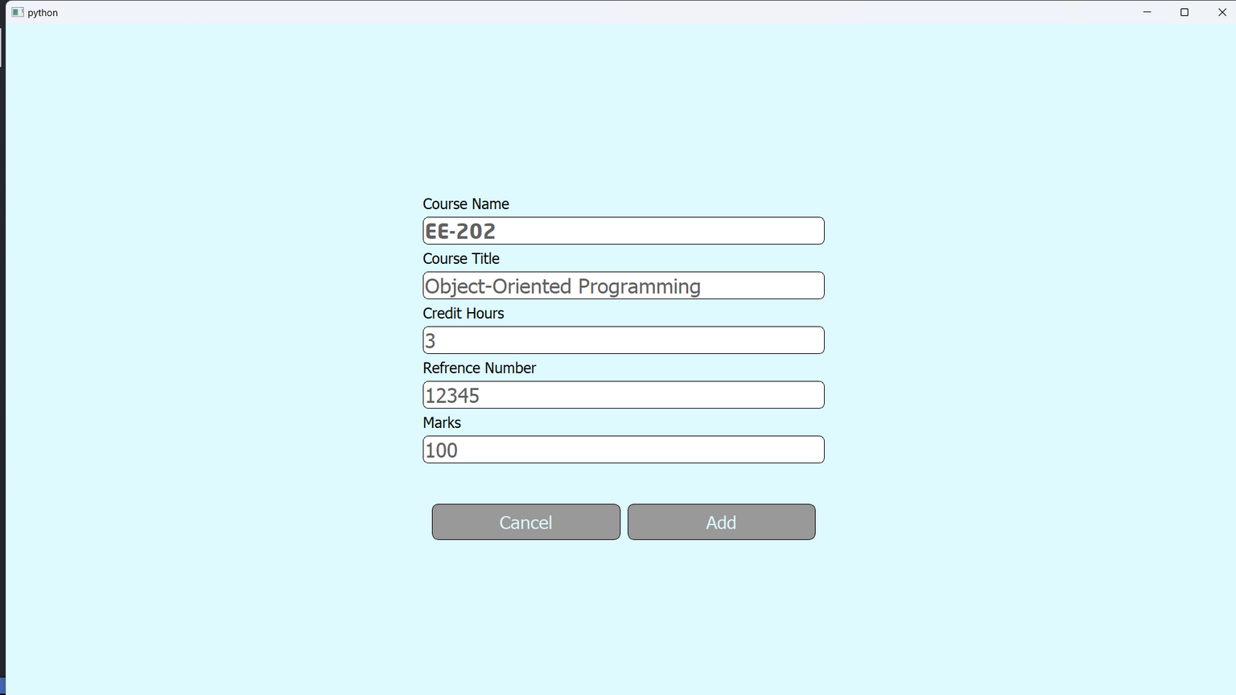

Slide 21
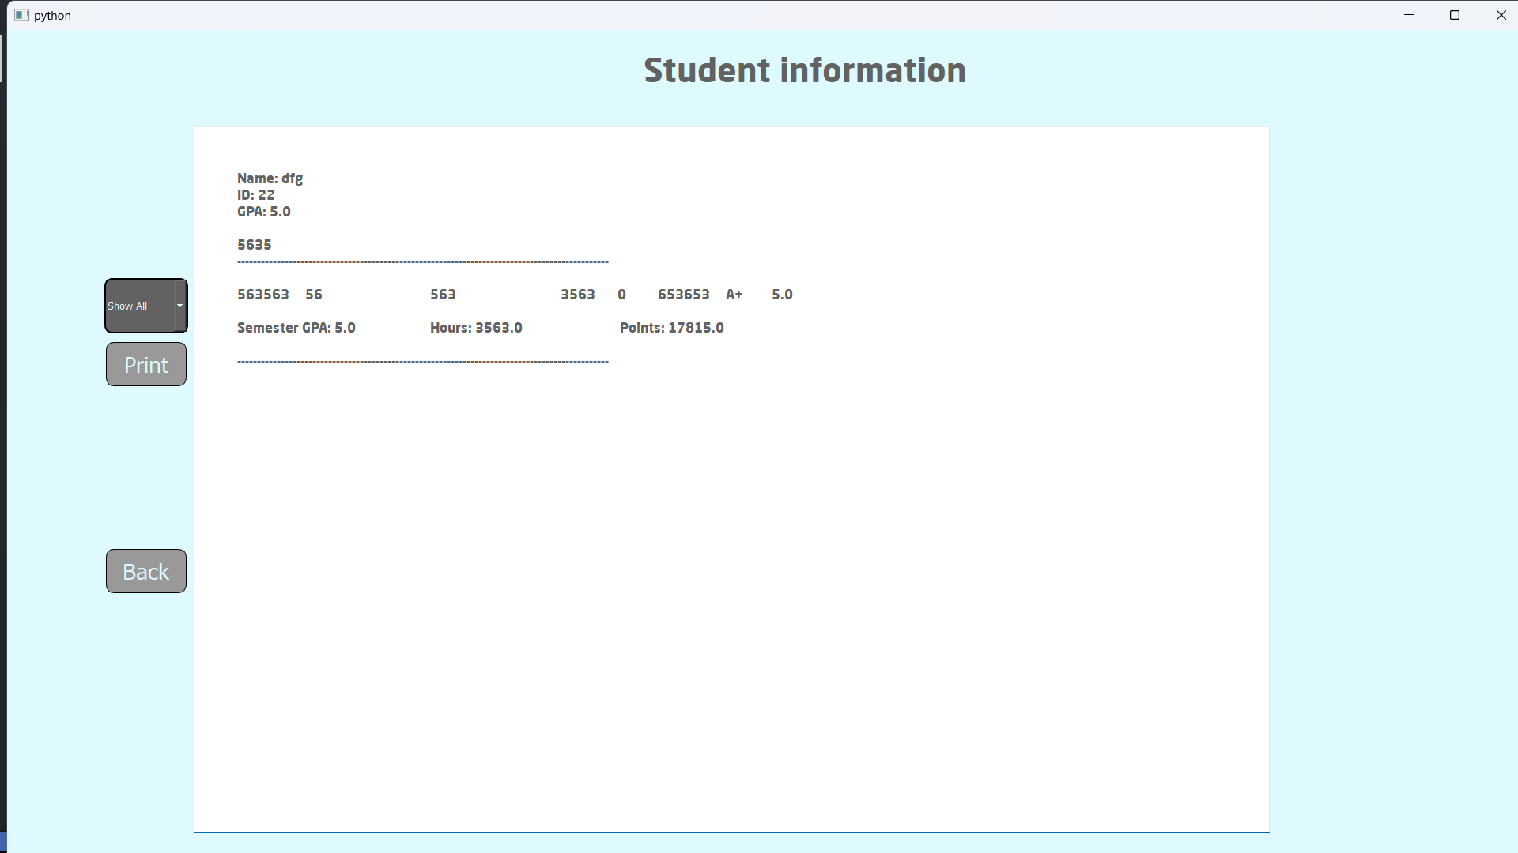

Slide 22
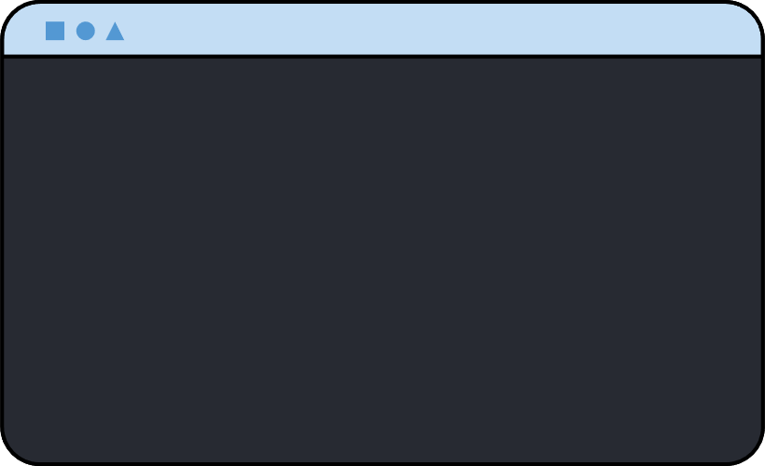

Thank You!!

